Slide 1
1
Welcome
to
Certification Planner LLC
Your Learning Club

Slide 2
Why Choose Us?
2
35,000+
200+
100+
96.24%
5
Courses
Accreditation
Professionals
Trained
Certified Instructors
Success Rate

Slide 3


What People Say About CP?
3
Jordon Smith
Jay Walker
Jessica Williams
Andrea Jones
I am happy to have chosen Certification Planner for the PMP certification training.
I took a Lean Six Sigma Green Belt (LSSGB) course with Certification Planner.
Awesome learning experience & excellent instructor having knowledge about subject.
Had a great experience with Certification Planner.
Ricky Harrington
Carol Johnson
Barbara Hewitt
Sophia Wilson
Certification Planner has done a great job to design entire course material and classes.
Joined LSS course & very happy with training and the material they offered for the same.
Have attended PMP class. Was great learning experience with an outstanding instructor.
I would definitely recommend CP to my friends and colleagues.

Slide 4








TRAINING TYPES
Your comfort is our priority. Hence, we have designed our training programs, keeping every individual in mind.
Select training that suits your style.
Corporate Training
Instructor-Led
Classroom
Instructor-Led
Online Classroom
Online Self Study

Slide 5

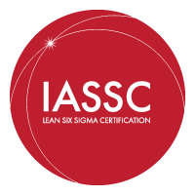










5
ACCREDITATION
TRUSTED BY GLOBAL LEADER

Slide 6


About Certification Planner
6
Our creative approach and progressive thinking makes us stand out from the crowd. Certification Planner is an organization that is driving progress by offering training on advanced and trending subjects. Being a responsible training provider, we always think about what further contribution we can make in assisting people to shape-up their career. Our clients are our priority, hence every new initiative at CP starts with a question: how can we deliver better to our customers? CP has a clear vision of what we want to achieve, and we guide our business towards the same direction.
At CP, we believe learning and adapting new technologies and upgrading skillset is the only way to achieve sustainable growth
CEO
Suhaan Kkhanna
Success Rate:
LSSGB, LSSBB, ITIL Foundation
94%
Veteran Planner
PMP
100%
LSSGB
"Power to Heroes"
100%
An initiative to support and upskill transitioning veterans into the corporate world.
LSSBB
89%
ITIL

Slide 7
Live Training
7
There is a real difference between hearing and listening. We hope this course material provides you with the reinforcement of the DMAIC process information gained through live training. If you are listening to the recorded session of this course, we highly recommend that you also participate in a live class. CertificationPlanner offers both in-person and live virtual (on-line) training courses. The ability to interact with a live instructor and other students exercises additional areas in your brain, to better reinforce and commit the knowledge presented. As a live student, you will have the ability to ask questions that interest you, obtain examples that relate to your area or expertise, access after class help, revisit questions on the material after class, obtain any resources provided by fellow students, as well as get tips on how to take the exam.
Contact Certification Planner(CP) today for more information.
Email: Support@certificationplanner.com Phone: +1855.322.1201 or www.certificationplanner.com
Once again welcome to Certification Planner. Let us know if you need any assistance.

Slide 8
About This Tutorial
There are a total of 6 lessons in the Dual Lean Six Sigma Green and Black Belt certification course.
Overview of Lean and Six Sigma
1
2
Define Phase
Measure Phase
3
4
Analyze Phase
Improve Phase
5
6
Control Phase
Practice Exams
7
8
Final Exam

Slide 9
9
Lesson 01 –
Overview of Lean and Six Sigma

Slide 10
Organizational Objectives
Successful organizations set and strive to achieve objectives
  An organizational objective reflects the organization’s goals, mission, and vision
In addition, these objectives should consider:
  Where an organization currently sees itself in an industry and where it wants to be
  What are its strengths, weaknesses, opportunities, and threats?

Slide 11
Lean Six Sigma Yellow Belt
These are the project-specific, full-or part-time resources that provide process and cross-functional knowledge, as well as help to sustain the gains. They have co-ownership of the project with the Six Sigma Experts and are responsible for the quality of the work and results.
This team also plays the critical role of translating the process gains from Six Sigma to other areas of the business after the specific project has been completed. This is the true leverage of Six Sigma methodology!

Slide 12
Deliverables of a Yellow Belt
A Yellow Belt has basic knowledge of Six Sigma
They do not lead projects on their own, as does a Green Belt or Black Belt.
YB participates as a core team member or subject matter expert (SME) on DMAIC project or projects. Supports Green Belt or Black Belt in developing process maps, helping with data capture, facilitating simulation, and improvements.
YBs may often be responsible for driving smaller process improvement projects using Lean tools or best practice sharing in their processes.

Slide 13
Benefits of being a Yellow Belt for Organization:
For any project, Yellow Belts are those individuals who are the Subject Matter Experts (SME’s) of their respective processes and also have the basic know-how of Six Sigma. They are the spokes of a wheel and can help drive any Six Sigma process to closure by using their process expertise. Organizations can greatly benefit by choosing the right YB’s for the right projects.
For yourself and your career, YB’s get exposure of channelizing their Subject knowledge to process improvement opportunities yielding tremendous benefits for self understanding.

Slide 14
Lean Six Sigma Green Belt
Six Sigma Green Belts are the engine of Six Sigma projects. Black Belt’s support the efforts of the broader business teams to identify and implement change. The GB’s are part-time Six Sigma Project Leaders. They are responsible for scoping the projects, leading the project team, calling for help when needed, managing interfaces with business leaders, and ensuring sustainable results.
The goal of GB’s is to translate the value of Six Sigma to the specific work environment and problems.

Slide 15
Deliverables of a Green Belt
Project Execution
Team and Project Structuring
Six Sigma Project Results
Share Best Practices

Slide 16
Benefits of being a Green Belt for Organization:
GB’s have authority in their respective processes and can get the work done effectively. This is a very critical aspect for the organization as it builds its process improvement structure within each process.
For yourself and your career, GB’s receive exposure to senior management directly by virtue of the projects and get the opportunity to make a difference in the organization.

Slide 17
Lean Six Sigma Black Belt
Six Sigma BB’s are full-time/part time project leaders and mentors of the business, including Green Belts and other associates. They have tactical responsibility for executing specific projects and ensuring that the results are captured, the changes are owned by the Champions (Sponsors), and the changes are sustained. They will also lead Six Sigma knowledge transfer to both full- and part-time participants.
BB’s are expected to create an environment of open, honest debate of facts. They challenge the status quo where appropriate and share (and seek) ideas across boundaries.

Slide 18
Deliverables of a Black Belt
Lean and Six sigma strategy and roll-out plan for the given process/area
Execute Projects
Help and guide Project Resources/ Help remove project level Barriers
Team and Project Structuring
6 sigma Project Results
Mentor Green Belts
Share Best Practices

Slide 19
Benefits of being a Black Belt for Organization and for self-career:
BB’s are responsible for taking the process improvements to the next level in the organization.
BB’s are highly trained on improving results for the organization using statistical analysis and Six Sigma tools. Hence, they have a very lucrative career path ranging from Business Analysts to Process Improvement experts.

Slide 20
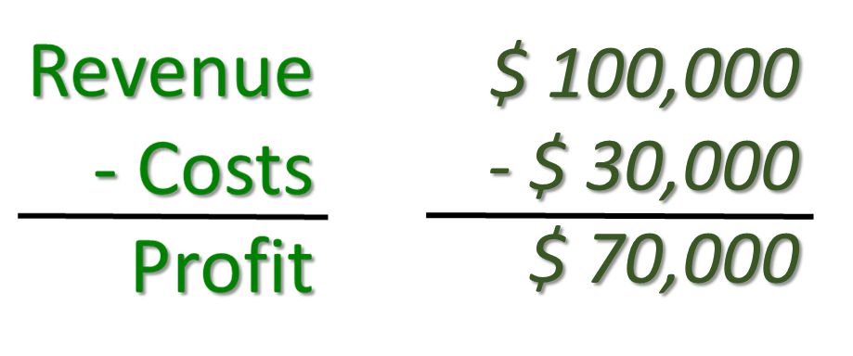
Profit: The Common Objective
Critical to every organization’s operational viability and success is its profitability
Lean Six Sigma practices share the organization’s objectives to maximize profits, with its primary focus being “Savings” (Cost reduction)
At the most basic level, profitability can be demonstrated with the following formula:

Slide 21
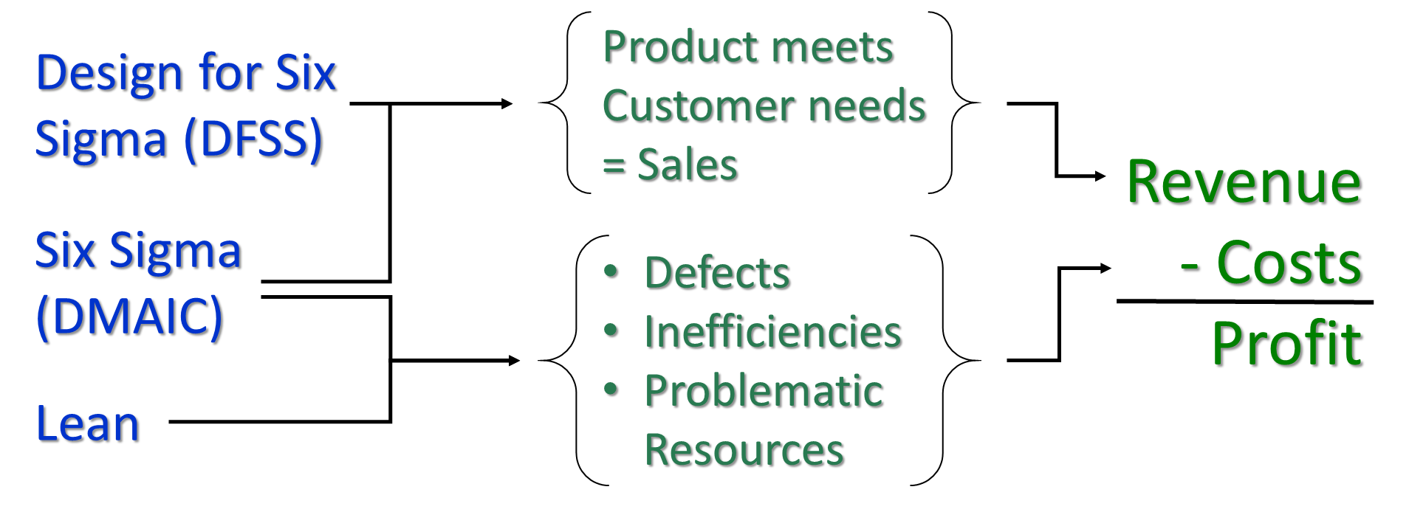
Profits & Lean Six Sigma
Following is a high-level look at how different Lean Six Sigma practices interact with this profit model

Slide 22
Course Overview
This course will provide an extensive amount of information, insight, expectations, and recommendations
The ultimate purpose of obtaining at Lean Six Sigma Green Belt is to continually seek valid, quality improvement efforts with educated and skilled methods

Slide 23
23
Lesson Completed

